Slide 1
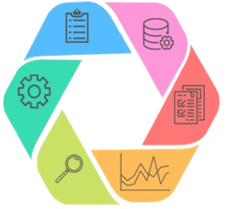
Life Cycle of a Data Science Project
Consulting Subcommittee
Qiaoxuan (Josh) Wang Joyce Lu

Slide 2
Background
- What’s a Data Science Project?
- What sets them apart?
- Why Call it a Lifecycle?
Life Cycle Stages
Engagement Activity
Q&A

Slide 3
[01] Background

Slide 4

What is a Data Science Project?
A practical application of technical skills & domain knowledge
Makes use of data to extract actionable insights and solve real-world problems
Combines principles and practices from a variety of fields
Common applications of data science in business include…
Quantifying Performance
Detecting Anomalies
Streamlining Operations
Informing Next steps
Source: What Is Data Science? 5 Applications in Business

Slide 5
What Sets Data Science Apart?
“Data Science enhances the traditional and more conservative world of Statistics with advanced algorithms to enable us to make sense out of soaring amounts of data”
Data science combines math and statistics, specialized programming, advanced analytics, artificial intelligence (AI), and machine learning with specific subject matter expertise to uncover actionable insights hidden in an organization’s data. These insights can be used to guide decision making and strategic planning.
Source: What makes Data Science different? A discussion involving Statistics2.0 and Computational Sciences

Slide 6
Why Call it a Lifecycle?
All data science projects are not built the same, so their life cycle varies as well. Still, we can picture a general lifecycle that includes some of the most common data science steps.
The term “lifecycle” refers to the iterative steps taken to build, deliver and maintain any data science product
The work is never truly finished – there is always something to refine!
Source: What Is Data Science Life Cycle? Steps Explained

Slide 7
[02] Life Cycle Stages

Slide 8
Ideation
The first step is to produce a clear definition and understanding of the problem or business case and then translate that into a data science problem with actionable steps and goals
Starts with “why”
State clearly the problem to be solved and why
Define the potential value of the forthcoming project
Identify the key stakeholders
Identify the type of problem being solved
Source: What is a Data Science Life Cycle? - Data Science Process

Slide 9
Data Acquisition
Collecting data from relevant sources either in structured or unstructured form
Some common ways to get data:
Kaggle
Public websites (i.e. government websites)
APIs
Web scraping
Gather your own data (i.e. surveys, questionnaire, etc.)
Source: Data Science life Cycle | Towards Data Science

Slide 10
Preparation
Once you have the data, start exploring it. You can conduct activities such as:
Document the data quality
Clean the data (i.e. should we omit, replace, or fill in missing data?)
Combine various data sets to create new views
Load the data
Present initial findings to stakeholders and solicit feedback
Source: Data Science life Cycle | Towards Data Science

Slide 11
Research & Development
Conduct Exploratory Data Analysis (EDA)
Use data visualizations to quickly understand features and their interactions
Conduct hypothesis testing or check any assumptions that you may have
What tools can we use?
Clustering and dimension reduction techniques
Univariate visualization
Bivariate visualizations and summary statistics
Multivariate visualizations
K-means Clustering
Linear regressions
Source: Data Science life Cycle | Towards Data Science

Slide 12
Research & Development (cont.)
Model Building
Data modeling: the process of converting raw data into a form that can be transverse into other applications as well
Mostly performed in using statistical tools and databases
Steps:
Developing datasets for training and testing
Choose the appropriate model that best fits the data and the question
Learn whether the problem is a classification, regression, or clustering problem
After analyzing the model family, choose the algorithms to implement them
Run the model
Source: Data Science life Cycle | Towards Data Science

Slide 13
Validation & Ethics Audit
Model evaluation
Using different evaluation metrics to understand a model’s performance
Continue to refine and reiterate the previous steps, tuning model parameters, until we reach a satisfactory performance
Understand model strengths and weaknesses
Interpret results
Ethics
Are you being fair, accountable, and transparent?
Are our findings reproducible? Do our findings/models add value?
Do they run the risk of harming anybody?
How can we prevent our findings from being misinterpreted?
Source: Chapter 5. Choosing and evaluating models

Slide 14
Present, Deploy, and Monitor
The final stage of the Data Science Lifecycle is to communicate your findings to your stakeholders and deploy the model in production in the desired format and preferred channel
The model you’ve built can be used on something as simple as an output on a Tableau dashboard or as complex as scaling it to the cloud for millions of users
Once your model has been deployed, you must continually monitor & maintain its performance to ensure that it’s meeting expectations, making enhancements as needed
Source: What is a Data Science Life Cycle?

Slide 15
[03] Engagement Activity
Kaggle Dataset
Workshop GitHub Repo

Slide 16
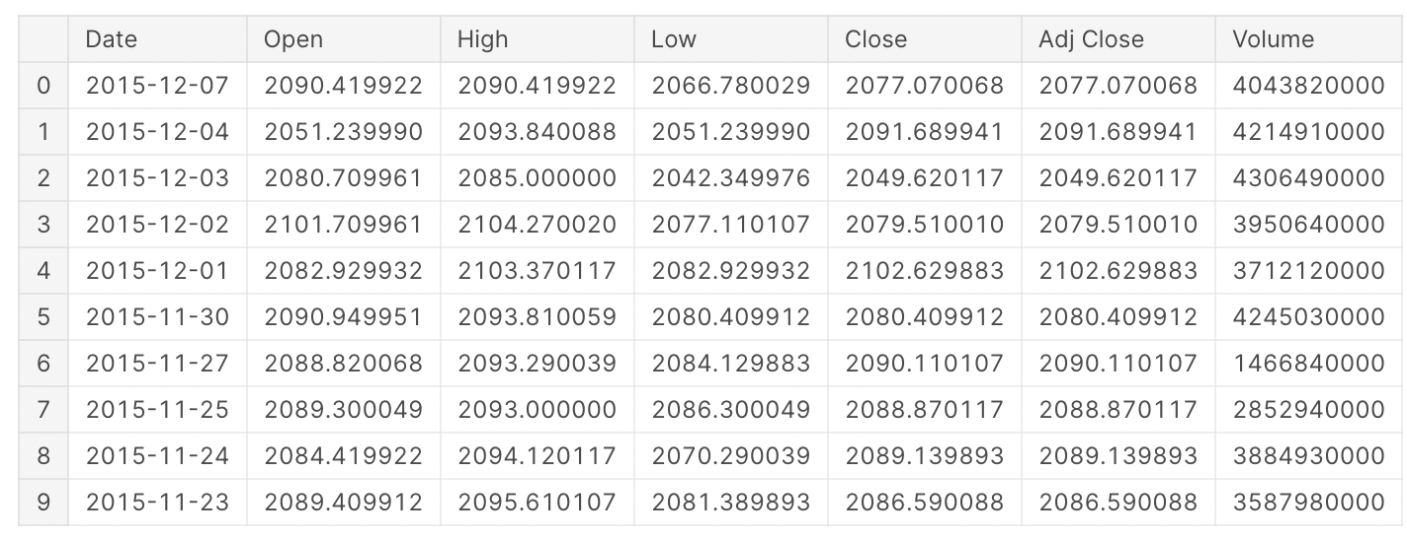
Yahoo Stock Price Dataset
First 10 rows
Notes:
The opening price is the price at which a security first trades when an exchange opens for the day
"Closing price" generally refers to the last price at which a stock trades during a regular trading session
Adjusted closing price refers to the price of the stock after paying off the dividends
Volume measures the number of shares traded in a stock or contracts traded in futures or options

Slide 17
1. Ideation
First, we need to define and understand the problem we want to solve:
What is the problem that we are trying to solve?
In this example, the author asked: What will be the value of Yahoo's assets in the near future?
Notes:
We don’t want to make our question too vague, because that would make it harder to decide what data we want to collect

Slide 18
2. Data Acquisition
Next, we want to collect the data we need
We have our data already!
What if today the data isn’t provided? What are some ways we can collect the data we need? What data do we want to collect?
Notes:
Most of the time we won’t have the data beforehand, instead we come up with a question first and then collect the data we need accordingly
We also want to make sure the source of the data is reliable

Slide 19
3. Data Preparation / Exploration
What are some tasks we can perform in this step?
Data Cleaning
Combining it with other datasets
Visualizing the data
Loading the data into a target location
…
Notes:
Some examples we talked about in previous slides today:
Data cleaning
sometimes raw data are messy because in real world, its common to get data that are unstructured or unfiltered, so we want to transform it into the format that is easier for future analysis; another example is how we want to deal with null values (remove, replace, etc.)
this example that we are looking at: the dataset is already pretty organized except for some null values which the author later removed
therefore, this is the most important step of a ds project, since bad data will mostly likely produce bad results
combining it with other datasets (for example, if we want to understand what role the inflation plays in this, we can find data related to that; or if we want to understand how stock price of competing companies affect Yahoo’s stock price…)
visualizing the data
loading the data into the target location (i.e. a cloud platform)

Slide 20
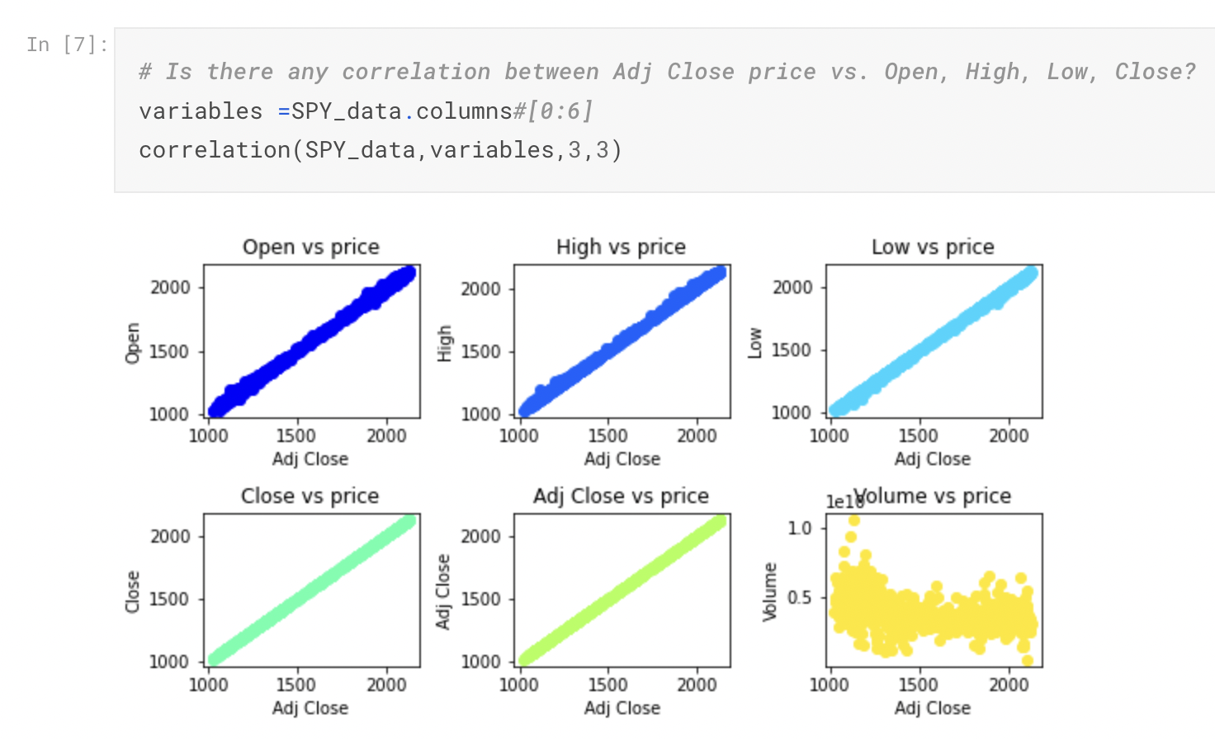
4. Research & Development
Conducting Exploratory Data Analysis (EDA)
Do we have any assumptions or hypotheses about the data?
What can you do / what tools can you use to quickly test your assumptions and understand the relationships between various features?
Notes:
Example of what the author of this kaggle case study did: she visualized the data to look at the correlation between adjusted close price versus open, high, low, and close price
This step is important as it helps us to identify and discover patterns that might be valuable

Slide 21
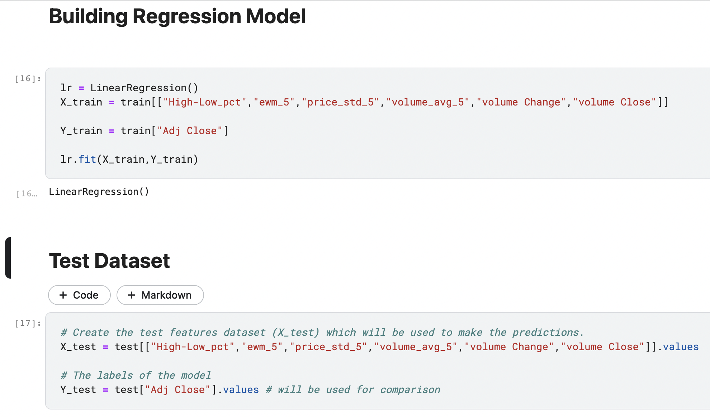
4. Research & Development
Model Building
What approach can we take?
What model is best fit for the data?
In this example, the author uses a regression model
The dataset is split into train & test sets
Notes:
Notice how the dataset is split into train & test datasets. The test dataset will later be used for comparison.
we should use the training set to build predictive models and leave the test set untouched
Then after training our model, we evaluate the model’s performance on the unseen data points, which come from the test set

Slide 22
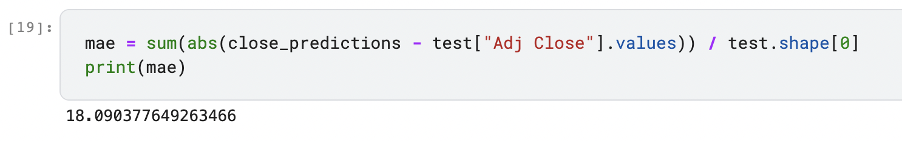
5. Validation & Ethics
Validation
In this case study, the author uses Mean Absolute Error (MAE) for model evaluation
What are some ways we can improve our model?
Notes:
MAE is a measure of errors between paired observations expressing the same phenomenon, in this case it’s actual values vs. predicted values.
Some ways to improve: change the model’s parameters
One thing to note is that we don’t want the model to overfit, which happens when the model has really small errors on training set but large errors in test set → we want the model to generalize instead of fit closely to data points in training set

Slide 23
5. Validation & Ethics
Ethical Considerations
Are we being fair, accountable and transparent?
Do they run the risk of harming anybody? If so, how?
How can we prevent our findings from being misinterpreted?
Are our findings reproducible?

Slide 24
6. Present, Deploy, and Monitor
We are at the final stage of the lifecycle of data science
If we are deploying a product, the model is exposed to real time data flowing into the system and outputs are being generated
It is important to maintain and keep updating the model and the data

Slide 25
[04] Q&A

Slide 26







Find us on social media!
@DS3UCSD
@DS3UCSD
Thank you!
Th
@DS3.UCSD
https://tinyurl.com/discordds3
ds3.ucsd.edu
ds3@ucsd.edu
Notes:
GBM is planned for next Thursday (September 24) at 6pm where all the Directors and PVP will be presenting for their respective organizations
How can I get involved? We are recruiting for most subcommittees
Active Community on Discord
People come from various backgrounds (check website for where we have interned, advice/tips), tutoring, HDSI Research Scholarship, professors, research at Qualcomm Institute, etc.
Opportunities, class questions, etc.
Tabling tomorrow! And next Tuesday (Library Walk) and Wednesday (EOTG), additionally we will be speaking at DSC classes either this week or next, etc.

